Slide 1

Customer Segmentation in E-commerce
W6W7W8 - Python Advanced Assignment
by Annita
RevoU FSDA Section Madrid - Team 5

Slide 2
TABLE OF CONTENTS
01
02
03
Business Overview
EDA
Cluster Analysis
Describing overview problem and project objectives
Understanding current business performance
Do cluster analysis for better targeting customer

Slide 3

01
BUSINESS OVERVIEW
Describing business problem and project objectives

Slide 4
OVERVIEW PROBLEM
An e-commerce startup based in Brazil recently opened an online website to sell their product. They launch the website when the Covid-19 hits and making them grow faster than ever. But, the startup is still not using targeted marketing which hurts their marketing budget as only a fraction of their user comes back to their website.
OBJECTIVES
The goal is to increase their marketing conversion rate by doing customer segmentation analysis to understand the customer's behaviour and planning targeted marketing strategy so that it will not hurt the budget anymore.

Slide 5
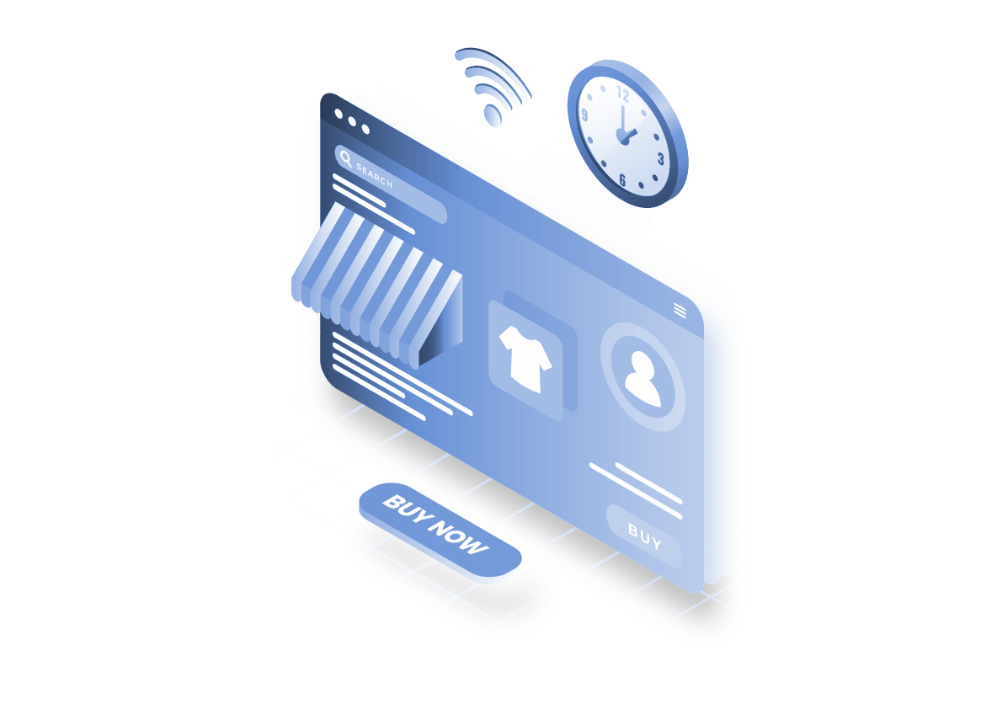
02
EDA
Understanding current business performance

Slide 6



DELIVERY TIME
Customer made purchase
Carrier is on its way
The order is finally delivered
It takes around 2 ~ 3 days in general for the e-commerce to process the customer’s order before they hand it to carrier.
It takes around one week in general for the carrier to deliver the order to customer’s address.
In general, it takes around 9 ~ 10 days since customer’s purchase date until the order arrive to the customer’s address. Based on estimation time, it takes around 23 days to finish an order.
However, there is still around 7.98% overdue delivered orders.

Slide 7
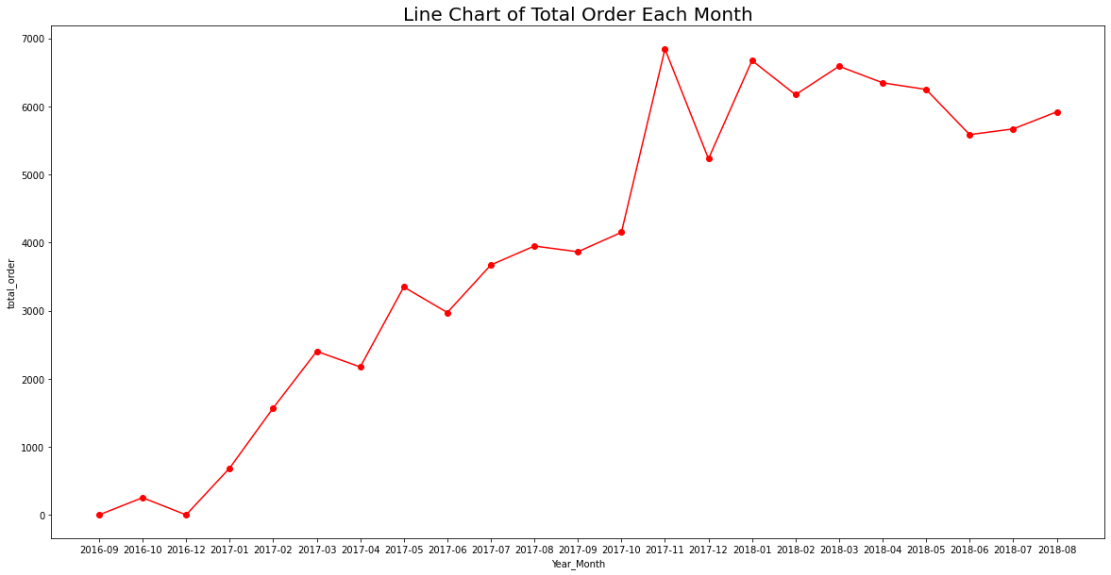
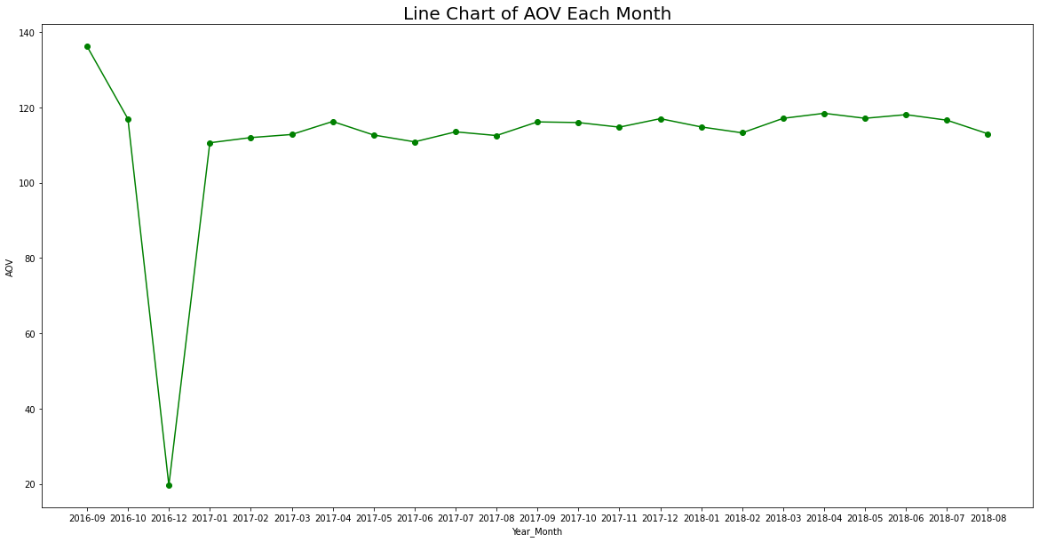
BUSINESS PERFORMANCE
Total Orders in Sept 2016 to Aug 2018
AOV in Sept 2016 to Aug 2018
From Sept 2016 to Nov 2017, number of order tend to increase. Largest increment happened from Oct 2017 to Nov 2017 (need investigation), but it decreases in Dec 2017. Start from Jan 2018, number of order increases from last month, but until Aug 2018, they tend to decrease slowly.
Average Order Value is quite stable for each month (around 110). AOV in Sept 2016 and Dec 2016 are fluctuate because total non-canceled or unavailable order is only one order.

Slide 8
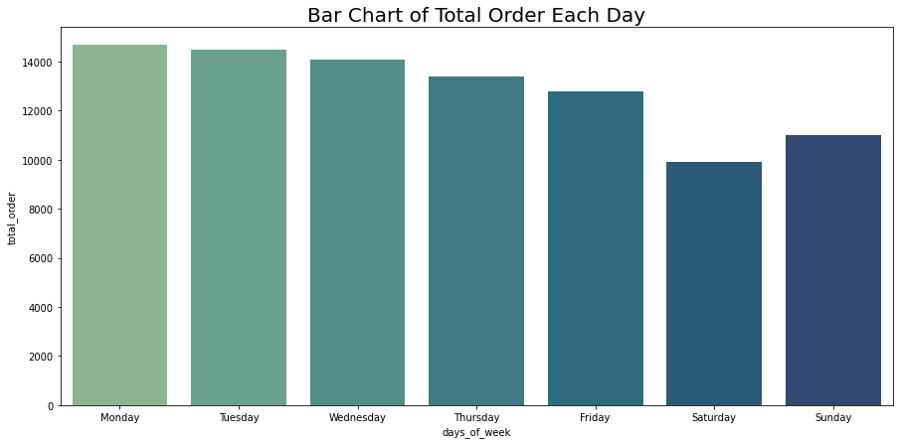
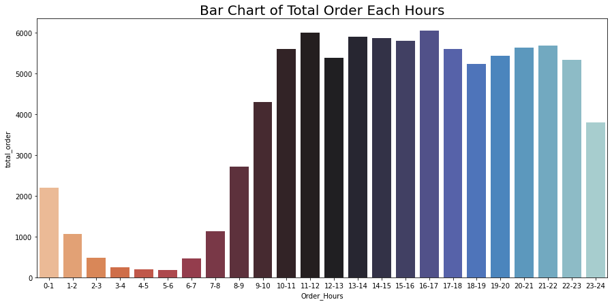
BUSINESS PERFORMANCE
Busiest Day in A Week
Busiest Hour in A Day
From 2016 to 2018, total order in weekday (Monday - Friday) is greater than weekend (Saturday & Sunday). Which means that the customer tend to buy in weekday rather than weekend. Besides, Monday and Tuesday become the busiest days in a week for three years.
From 2016 to 2018, most of the customers do purchase in 10 AM to 11 PM. Highest total orders happened in 11-12 and 16-17.
*Busiest Day and Hour are based on number of order for three years.

Slide 9
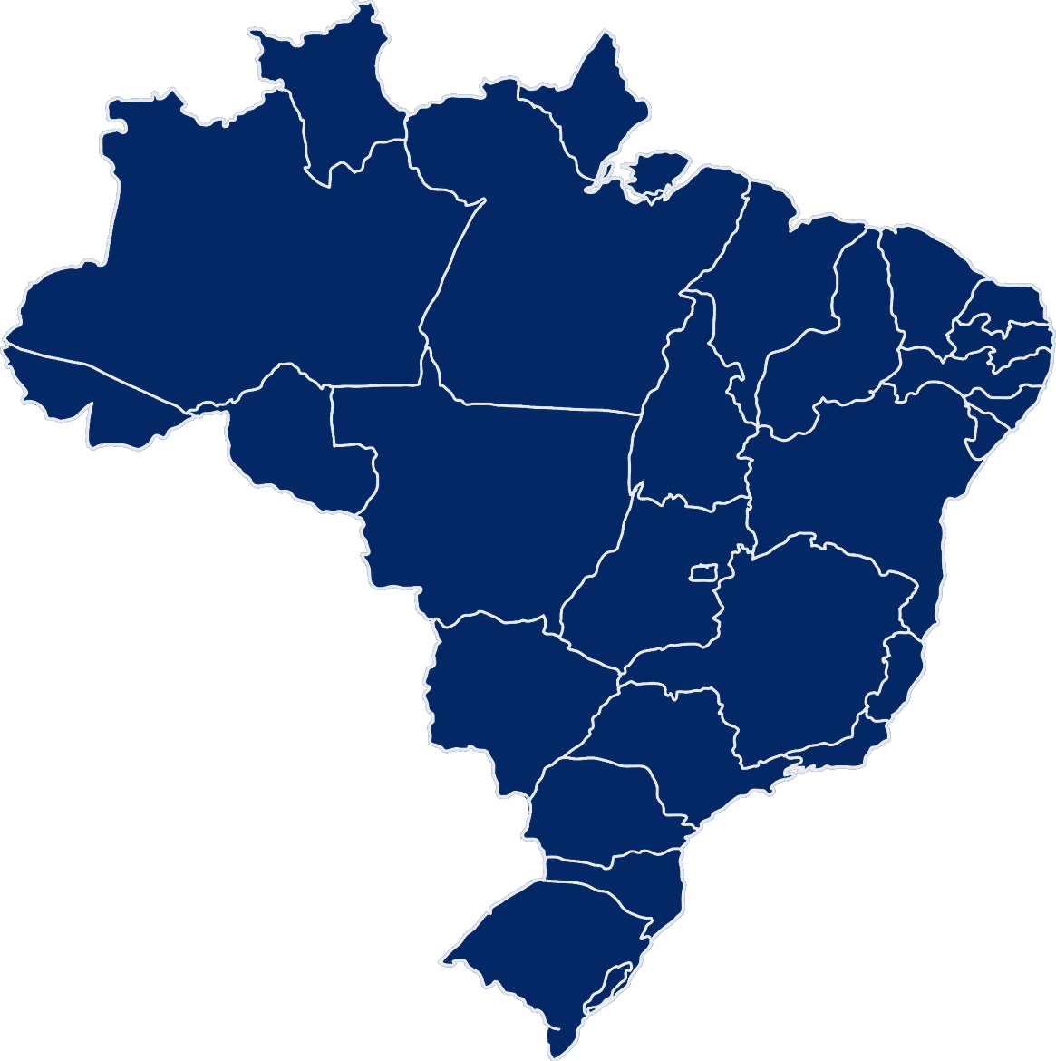
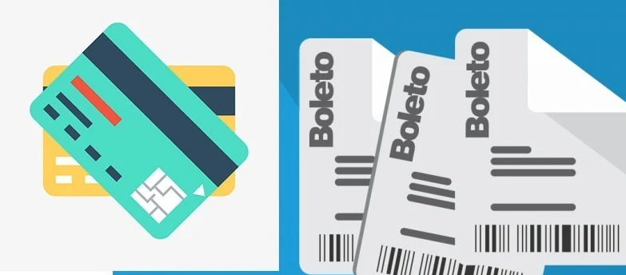
OUR CUSTOMER
Top 10 States with Most Customer
São Paulo
(42.56% of customer, ARPC = 107)
Rio de Janeiro
(12.91% of customer, ARPC = 120.52)
Minas Gerais
(11.76% of customer, ARPC = 121.06)
Rio Grande do Sul
(5.5% of customer, ARPC = 121.88)
Paraná
(5.06% of customer, ARPC = 116.6)
Santa Catarina
(3.64% of customer, ARPC = 124.64)
Bahia
(3.34% of customer, ARPC = 124.49)
Distrito Federal
(2.16% of customer, ARPC = 118.63)
Espírito Santo
(2.06% of customer, ARPC = 119.02)
Goiás
(2.01% of customer, ARPC = 121.6)
Our customers come from 27 different states, but 91% of our customers come from Top 10 States above. Although São Paulo has the biggest percentage of customers, the Average Revenue per Country is the lowest among the other 26 states.
There are 4 payment methods, but most of our customers love to pay with credit card and boleto. (The others are voucher and debit card)

Slide 10
RECOMMENDATIONS
Based on results of Exploratory Data Analysis, there are several recommendations that can be given :
In order to increase Average Order Value, we can try cross sell complementary product and upsell our products or even provide bundle deals, this will encourage customers to buy more complete products (and more expensive of course), thus increasing our average order value.
For efficiency cost and human resources, we can create an effective working schedule to allocate more workers on weekdays, especially Monday and Tuesday, and allocate less workers on weekend.
We can run limited-time offers to boost sales in several busiest hours.
For increasing Average Revenue per Country, we can create order minimums for free shipping. This will encourage customers to add more products to their carts, and if their amount of order surpasses certain amount, they will get free shipping coupon.
Most of our customers are credit card or boleto users, we can reward our existing customers by giving discount or cashback for selected payment method. Not only that, we should pay more attention to our security and customer service in order to minimize payment failure and payment fraud.

Slide 11
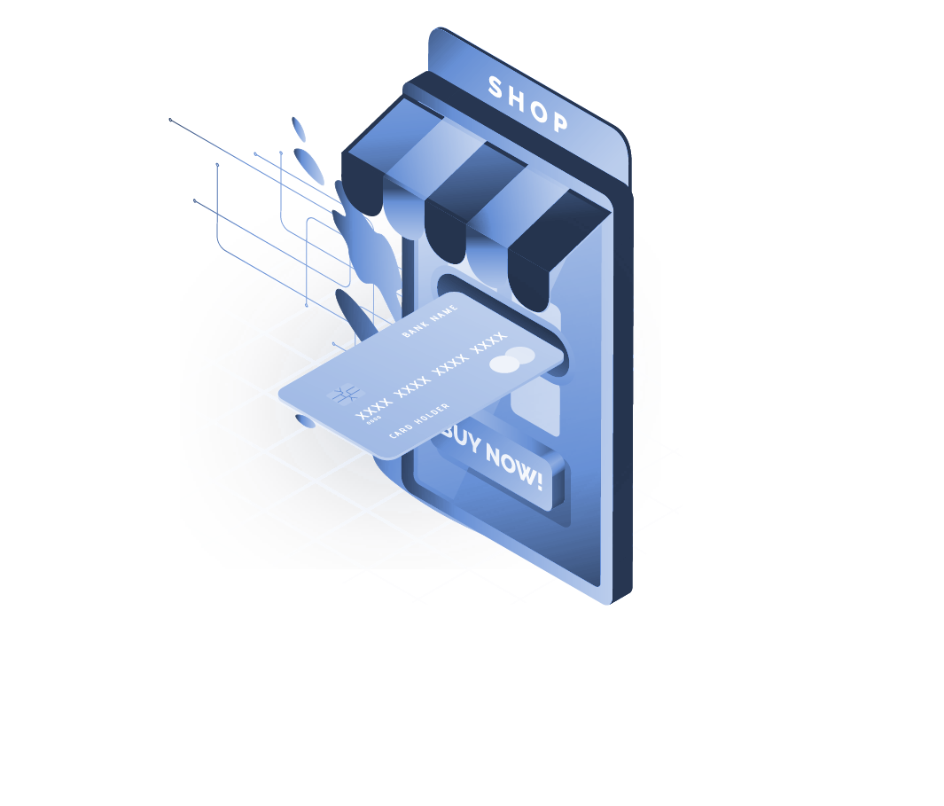
03
CLUSTER ANALYSIS
Do cluster analysis for better targeting customer

Slide 12
CLUSTERING PROCESS
Data Preparation
Cluster Analysis
Business Recommendations
Prepare the datasets for cluster analysis
Determine cluster number and fit the data to model
Give recommendations for improve business
Data Preprocessing
Interpreting Results
Checking outliers and scaling the numbers
See the behaviour for each cluster

Slide 13


DATA PREPARATION
Import Datasets
Clean & Merge
Removing Data
Create Table
Import three datasets that are going to be used in this project.
Handling unlogical, missing, duplicates, typos and outliers values for each datasets and merged them become one dataset.
Removing unused rows and columns.
Create RFM Table for doing Cluster Analysis

Slide 14
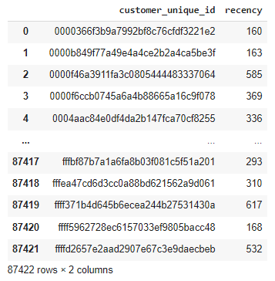
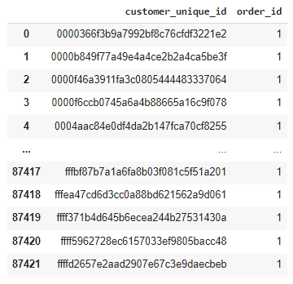
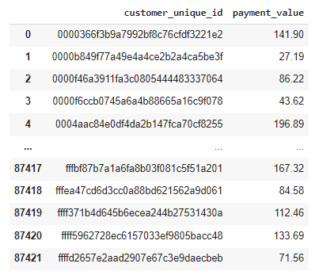
CREATE RFM TABLE
Recency
Frequency
Monetary
It shows time since last order from customer.
It shows total number of transactions purchased by customer.
It shows transaction value that customer spends in total.
First, find the last date purchase for each customers. Then, calculate recency since last date purchase made in the e-commerce.
Find total number of transactions purchased by each customer.
Calculate total transaction value that customer spends in the e-commerce.

Slide 15

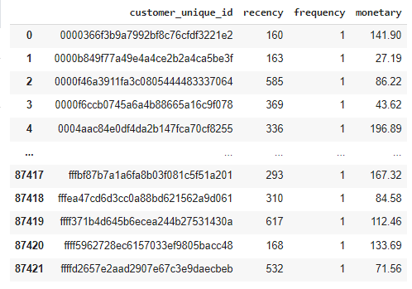
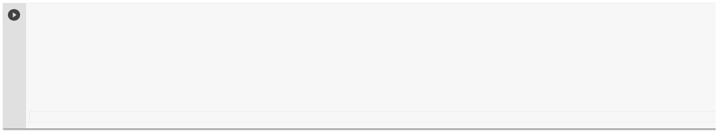
MERGE RFM TABLE
Recency
Frequency
Monetary
It shows time since last order from customer.
It shows total number of transactions purchased by customer.
It shows transaction value that customer spends in total.
# Join all the tables
RFM_table = pd.merge(pd.merge(df_recency, df_frequency, how='inner'), df_monetary, how='inner')
# Rename the column name
RFM_table.rename(columns={'order_id':'frequency', 'payment_value':'monetary'},inplace = True)
RFM_table

Slide 16
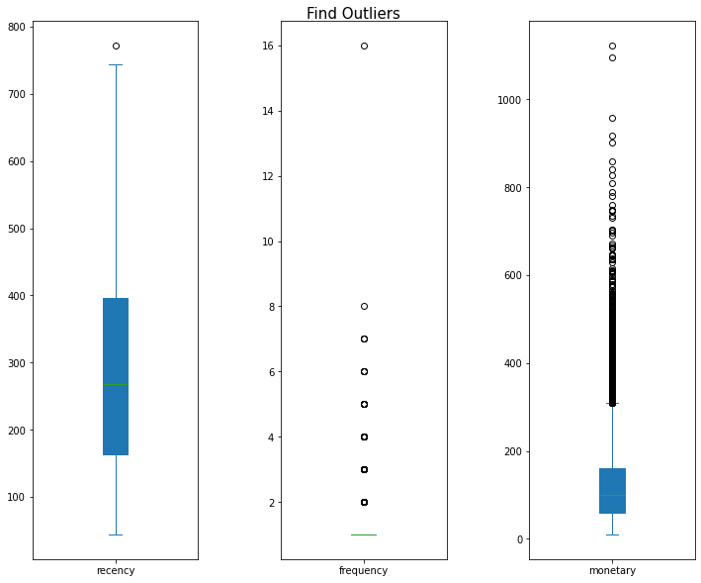
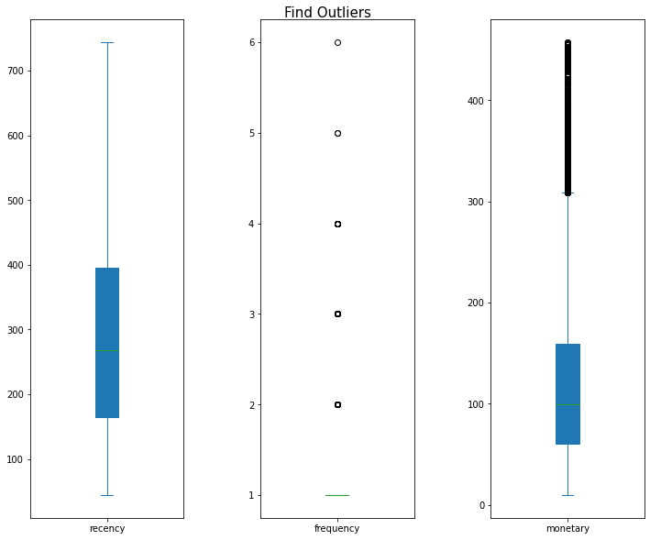
DATA PREPROCESSING
Checking Outliers
Before Treatment
After Treatment
For recency column, the outliers will be removed by Lower & Upper Inner Bound method (1.5*IQR).
For frequency column, the outliers are simply removed for frequency greater than 7.
Total rows :
87422 rows → 87257 rows
For monetary column, the outliers will be removed by Lower & Upper Outer Bound method (3*IQR).

Slide 17
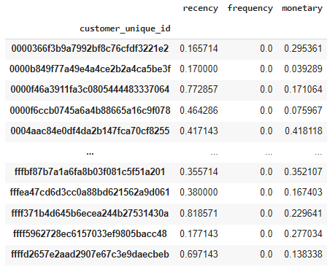
DATA PREPROCESSING
Scaling The Numbers
Since each of numerical columns have different scale, so all of numerical values will be scaled by using MinMaxScaler method.
# Import Library
from sklearn.preprocessing import MinMaxScaler
numerical_column = ['recency', 'frequency', 'monetary']
# Scale DataFrame by using MinMaxScaler
scaler = MinMaxScaler()
RFM_scale[numerical_column] = scaler.fit_transform(RFM_scale[numerical_column])
RFM_scale
MinMax Scaler will shrinks the data within the given range, in this project, range from 0 to 1 will be used.

Slide 18
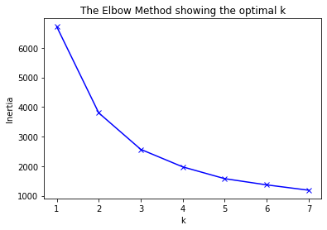
CLUSTER ANALYSIS
Determine Number of Cluster
Elbow Method and Silhouette Analysis will be used for determining optimal number of cluster.
Elbow Method
# Create Elbow Plot for Determining Number of Cluster
distortions = []
K = range(1,8)
for k in K:
kmeanModel = cluster.KMeans(n_clusters=k)
kmeanModel.fit(RFM_scale)
distortions.append(kmeanModel.inertia_)
plt.figure(figsize=(25,10))
plt.figure()
plt.plot(K, distortions, 'bx-')
plt.xlabel('k')
plt.ylabel('Inertia')
plt.title('The Elbow Method showing the optimal k')
plt.show()
From the graph above, it is clear that number of k = 2 or 3 will be the optimal for number of cluster. But for more accurate analysis, Silhouette Analysis will be performed.

Slide 19
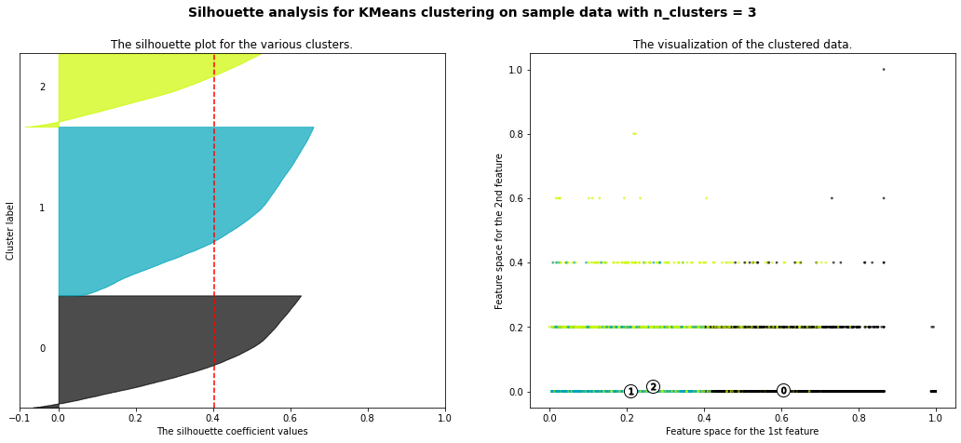
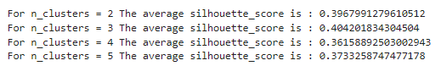
CLUSTER ANALYSIS
Determine Number of Cluster
Elbow Method and Silhouette Analysis will be used for determining optimal number of cluster.
Silhouette Analysis
# Import Library
from silhoutte import silhoutte_analysis
# Perform silhouette analysis for determine the number of cluster
silhoutte_analysis(RFM_scale,[2,3,4,5])
From the Silhouette Score and Silhouette plot, k = 3 will be chosen as number of cluster because average silhouette score reach the highest when number of cluster is 3.

Slide 20
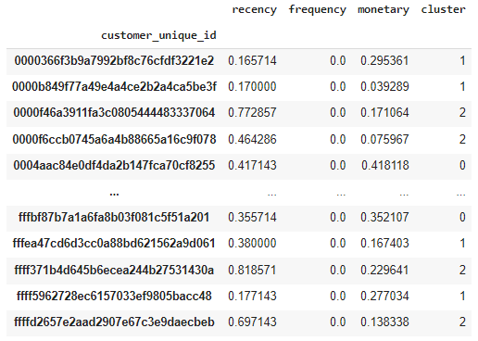
CLUSTER ANALYSIS
Fit Data Into Model
After determining the number of cluster, the next step is fit the data into cluster model.
# Import Library
from sklearn import cluster
cluster_model = cluster.KMeans(n_clusters=3,random_state=2)
cluster_model.fit(RFM_fitmodel)
cluster_label = cluster_model.labels_
RFM_fitmodel['cluster'] = cluster_label
RFM_fitmodel
In this project, K-Means Clustering Method will be used.

Slide 21
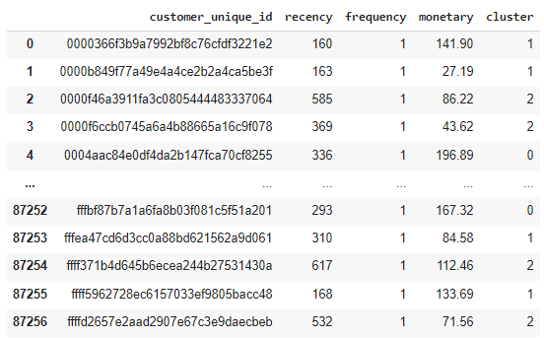
CLUSTER ANALYSIS
Bring The Cluster To Data
After determining the number of cluster and fit them into the model, finally bring the cluster to the original data.
By having the cluster information, the next step is interpreting the descriptive statistics for each columns to understand the clusters’ behaviour.

Slide 22
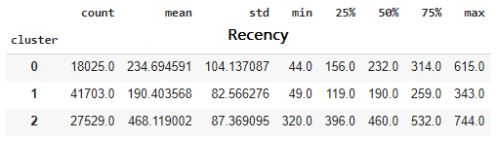
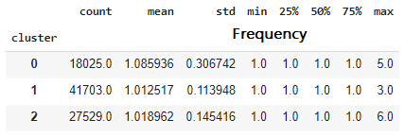
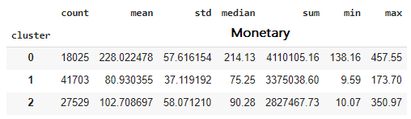
INTERPRETING RESULTS
Descriptive Statistics
By performing descriptive analysis, each clusters’ behaviour will be interpreted in order to give suitable recommendations.
From the table above, it can be concluded that :
Cluster 0 is customer’s cluster who made purchase a quite long time ago, they only come one time but they spent highest amount of money among the others. Although their population is the smallest, they contribute the most sales in e-commerce.
Cluster 1 is customer’s cluster who spend lowest amount of money but they are most recent purchasers but also one-time buyers. They dominate most of our customer population.
Cluster 2 is customer’s cluster who made only one purchase and hasn’t been back for very long time, but they spent moderate amount of money.
Most of our customers are one-time purchasers.

Slide 23
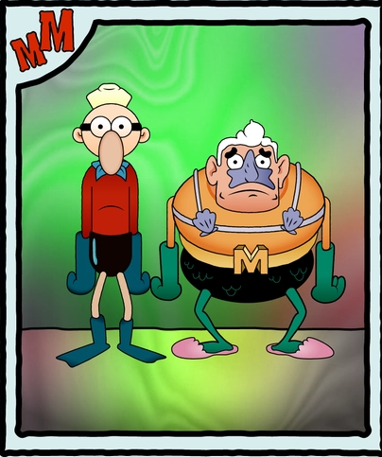




NAMING THE CLUSTERS
Loyalist Squarepants!
Sleeping Snorlax ~
Minions on Shopping :D
20.66% of customers
31.55% of customers
47.79% of customers
They only come one time and haven’t been back for a quite long time, but they spend much amount of money as long as they happy. They spend the highest amount among the others.
They spend moderate amount of money, also come only one time but they made their purchase long long time ago.
They are recent purchasers who dominate the customer population, but they spend less money and also come only one time. They spend the lowest among the others.

Slide 24

BUSINESS RECOMMENDATIONS
Loyalist Squarepants
Giving special new product introductions based on their purchase product history. We can also try add cross/up-sells strategy such as bundling in order to increase their AOV. Sending special voucher on special day will make them feel special too!
Minions on Shopping
Giving welcome discount with small rate or amount will make them feel welcome to our e-commerce. Build a promote referrals/review program is also recommended, so we can turn them into our advocates while acquiring new customers and gain positive image to our customers.
(20.66% of customers)
(47.79% of customers)
Sleeping Snorlax
Bring them back with Reactivation campaign or promotions (not too often), and run e-mail surveys to find out the reasons why customers didn’t come back. If possible, we can try giving discounts, but we need to consider our marketing budget.
Overall Customers
Build a membership programs where customers get certain points for every purchase they make that can be encashed during the next purchase. Also create VIP programs with exclusive offers specifically for high-contribute customers. This will encourage new customers to shop/spend more and join the group.
(31.55% of customers)

Slide 25

Thankyou!
Customer Segmentation in E-commerce
W6W7W8 - Python Advanced Assignment
by Annita
RevoU FSDA Section Madrid - Team 5

